Slide 1
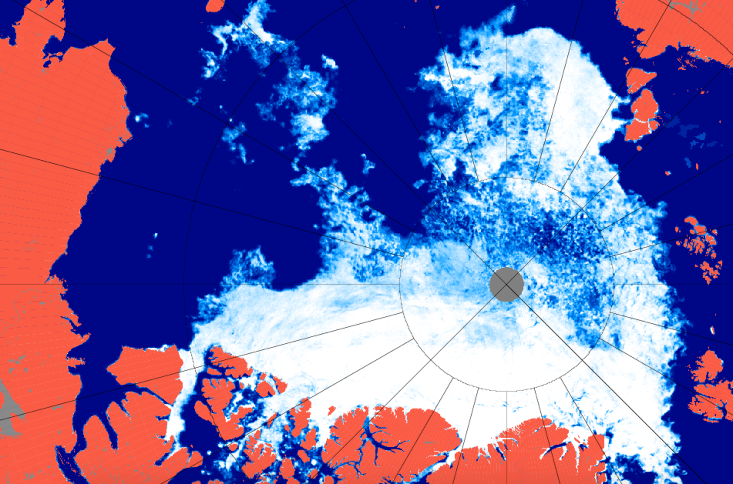
Looking for clues to changes in Arctic
sea ice
Zachary Labe
zlabe@uci.edu
@ZLabe
Climate Science • DSI Hackathon • 2017

Slide 2
The Arctic is undergoing dramatic changes.

Slide 3
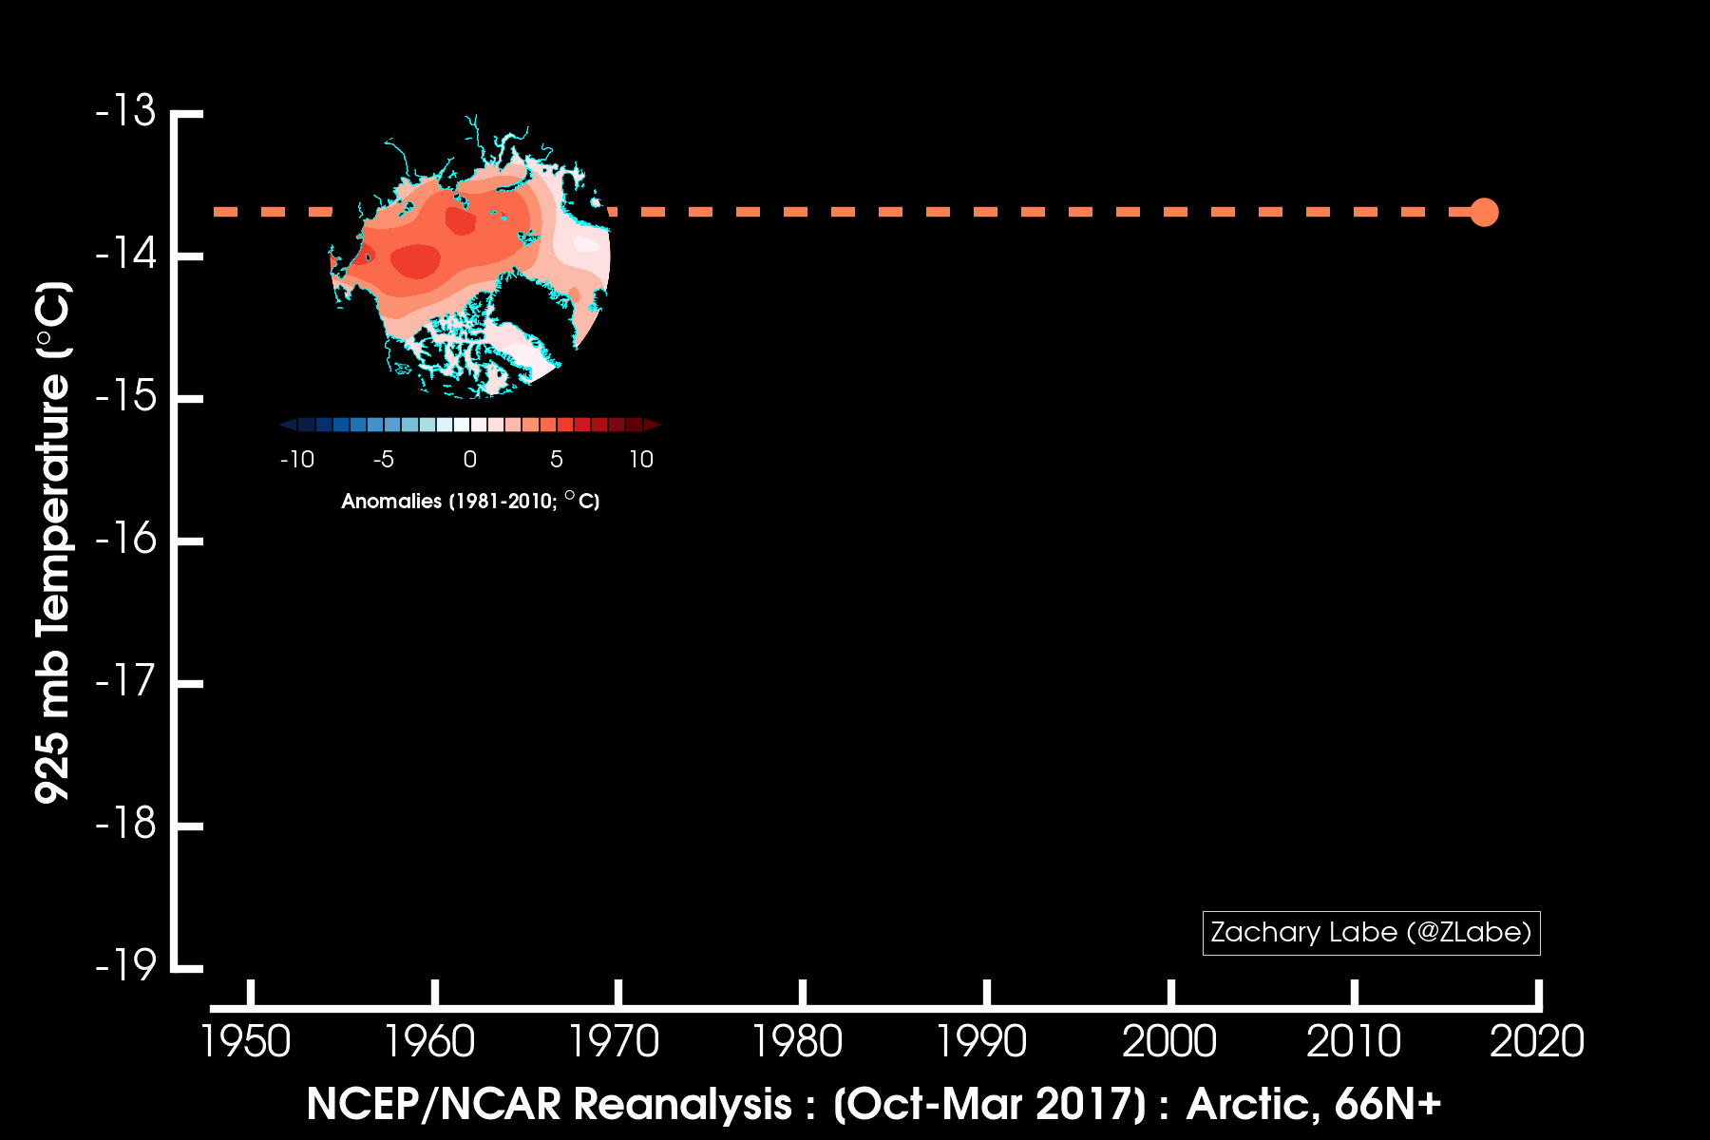

Slide 4
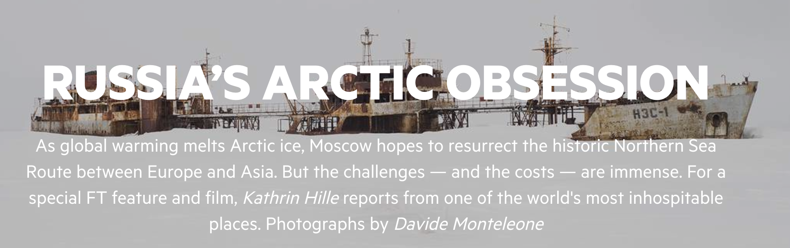

Slide 5
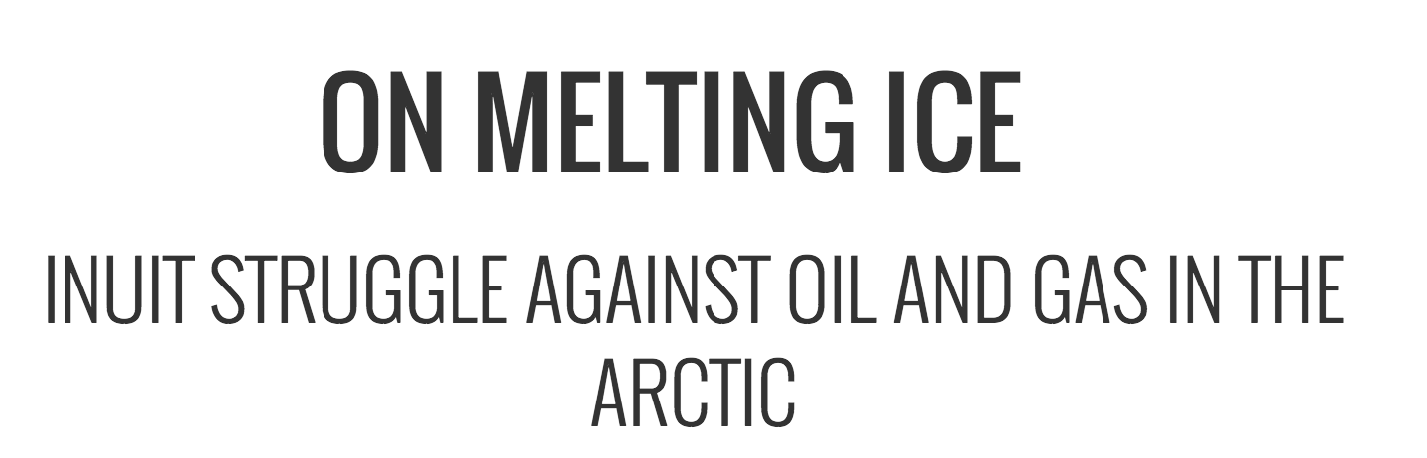

Slide 6
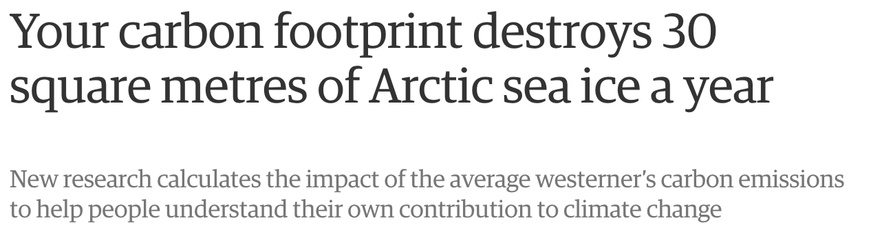

Slide 7
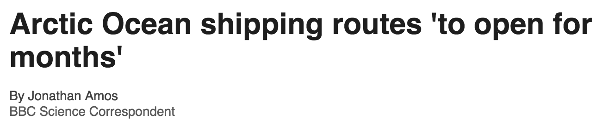

Slide 8
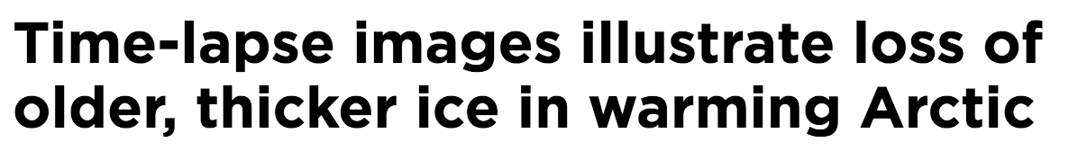

Slide 10
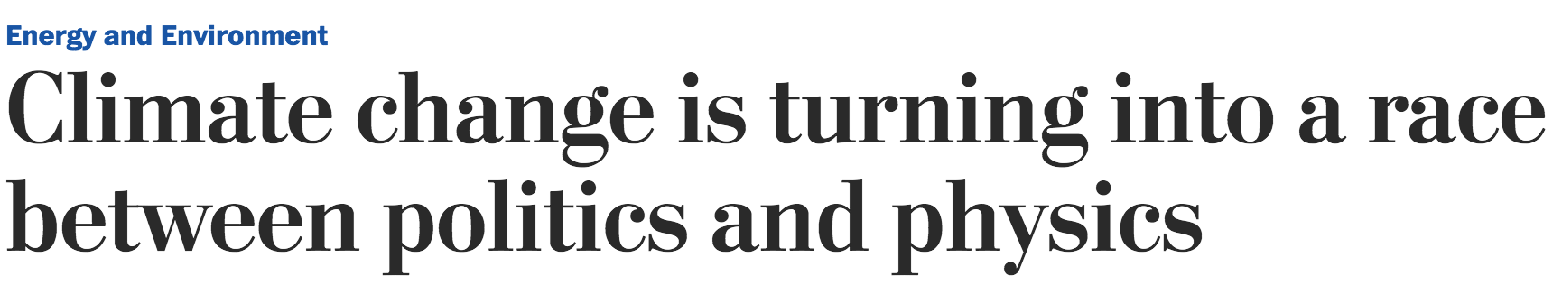

Slide 12
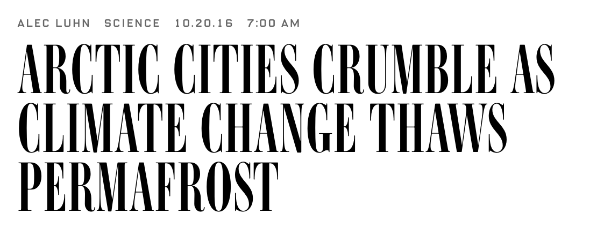

Slide 13
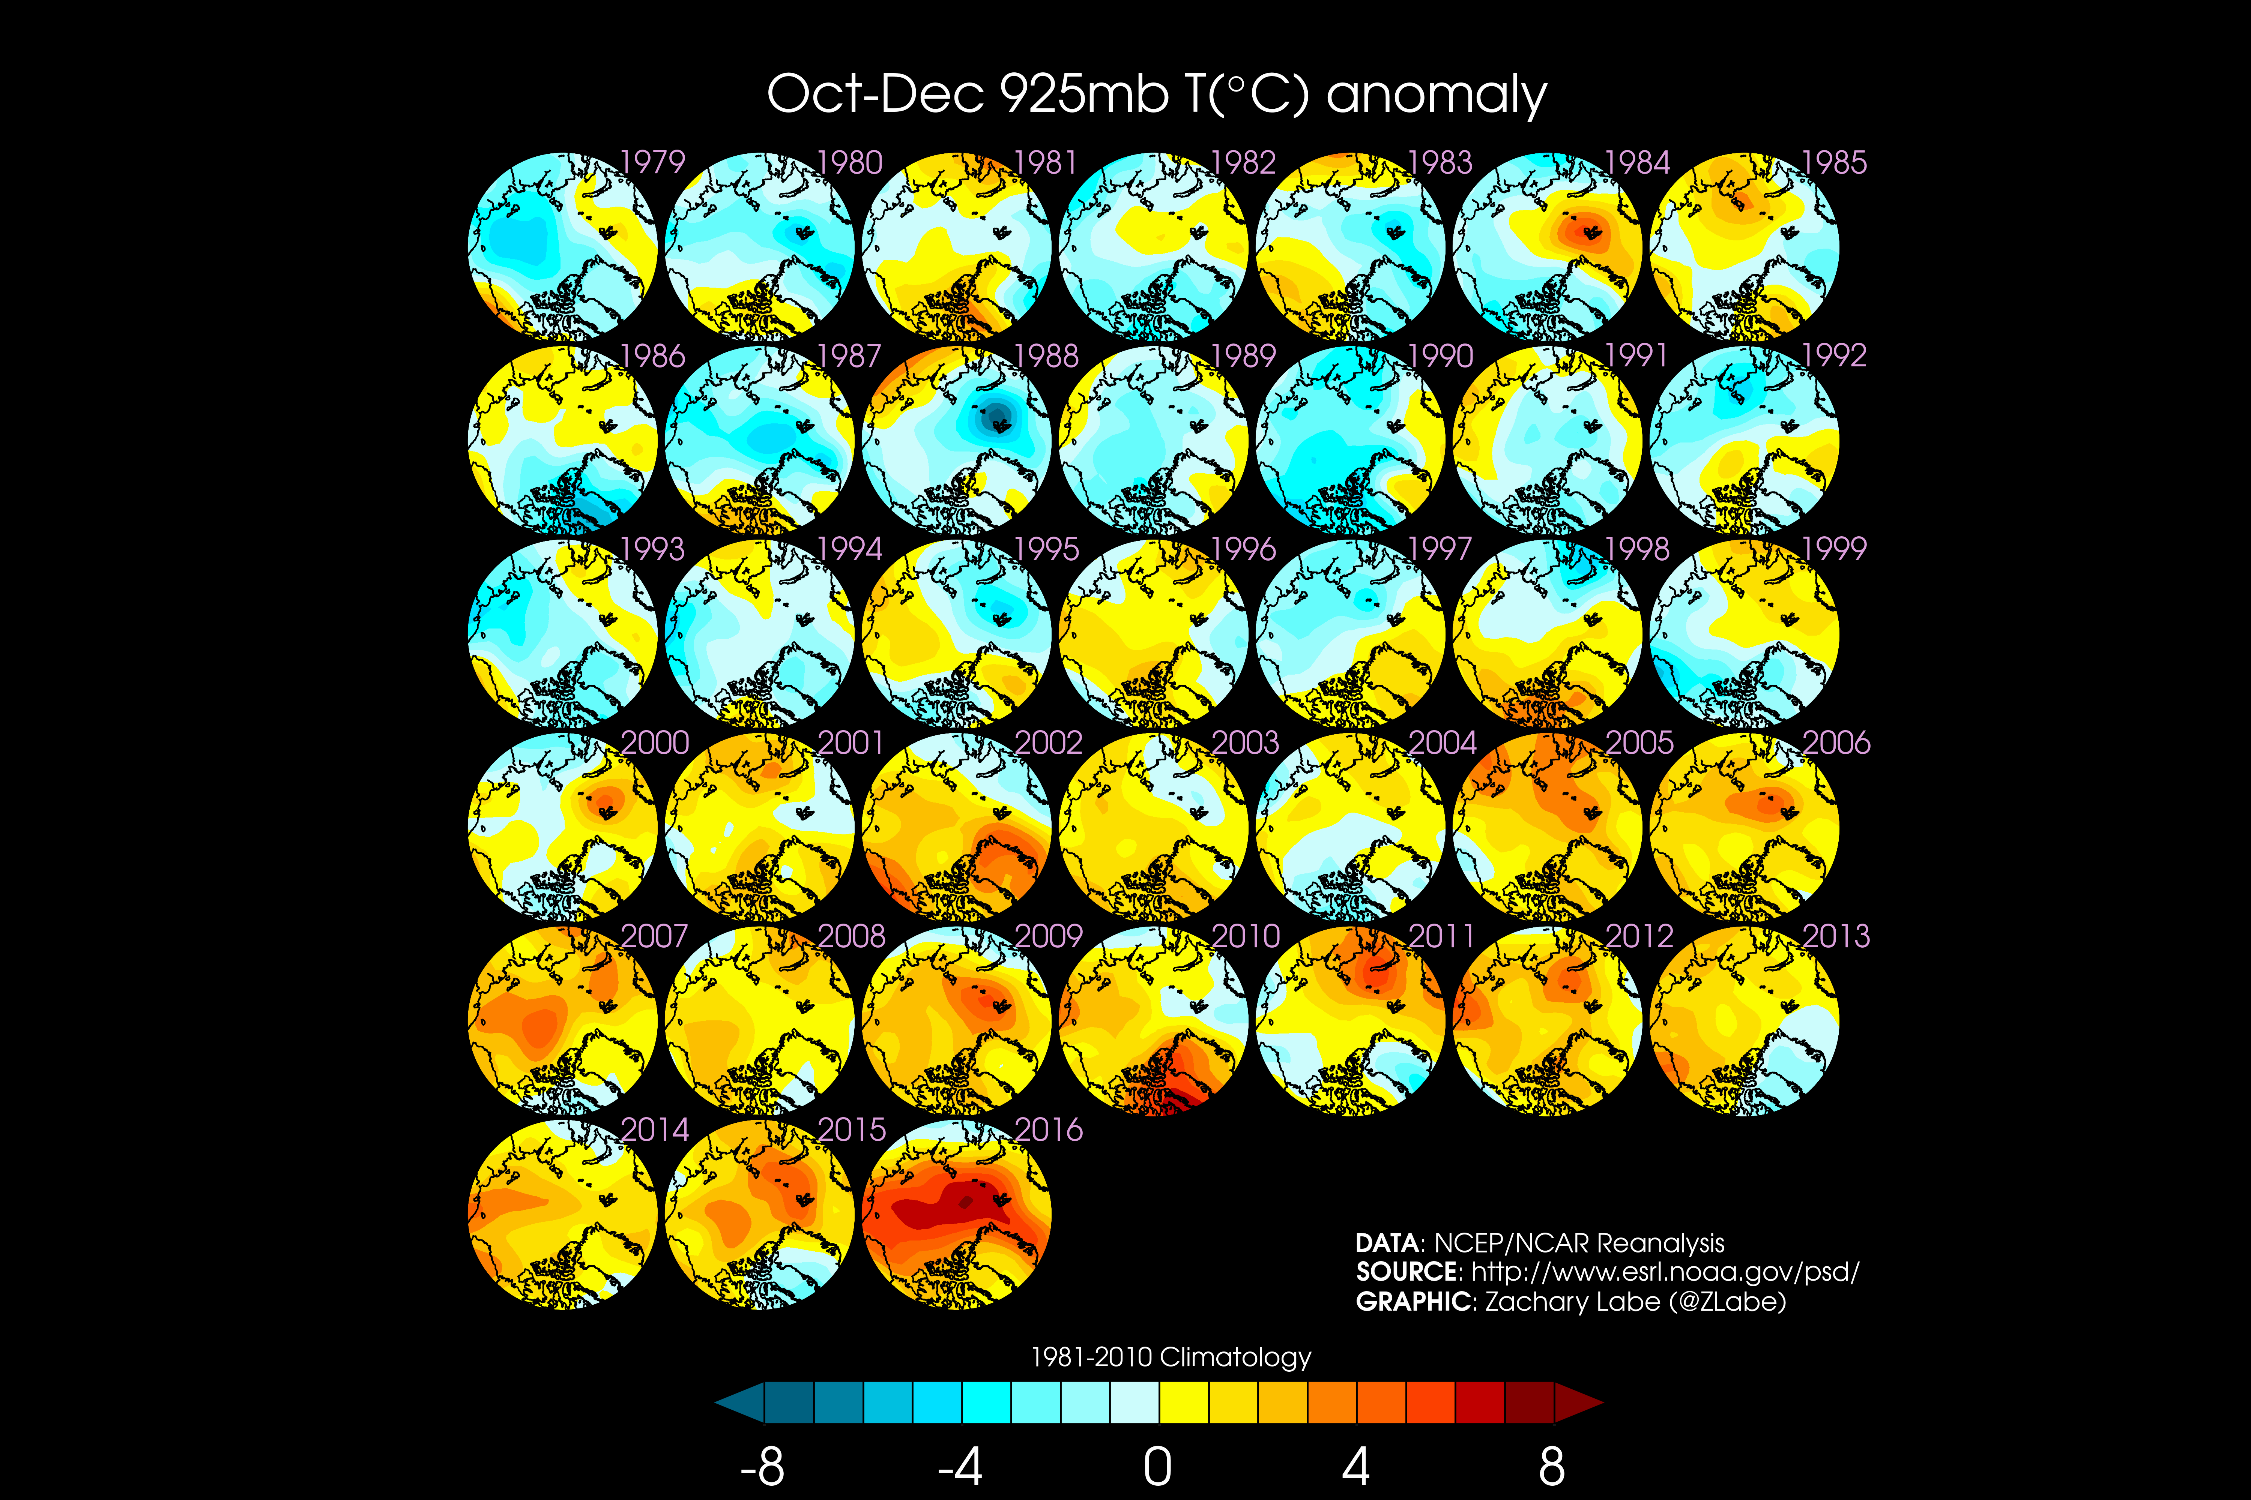

Slide 14
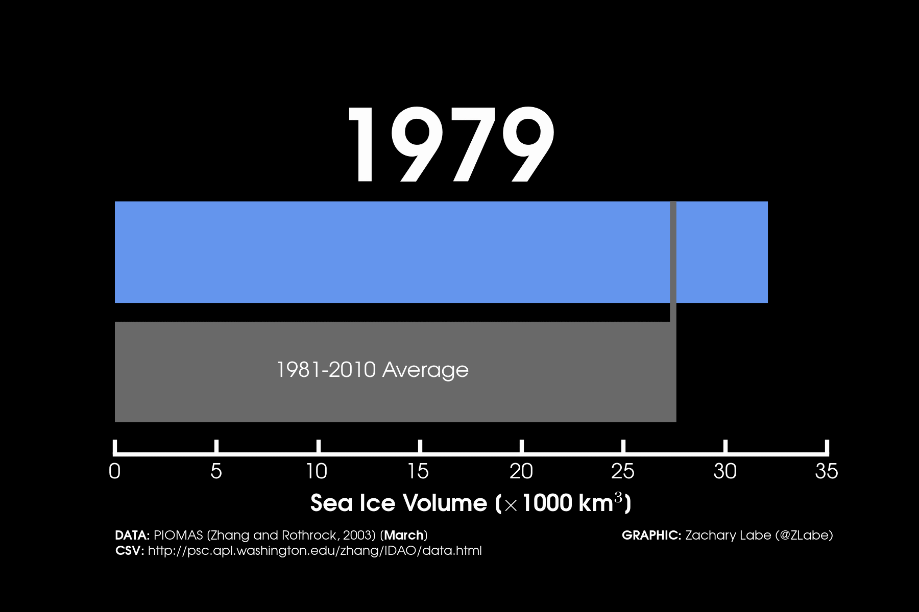

Slide 15
How do these changes compare to the past?

Slide 16
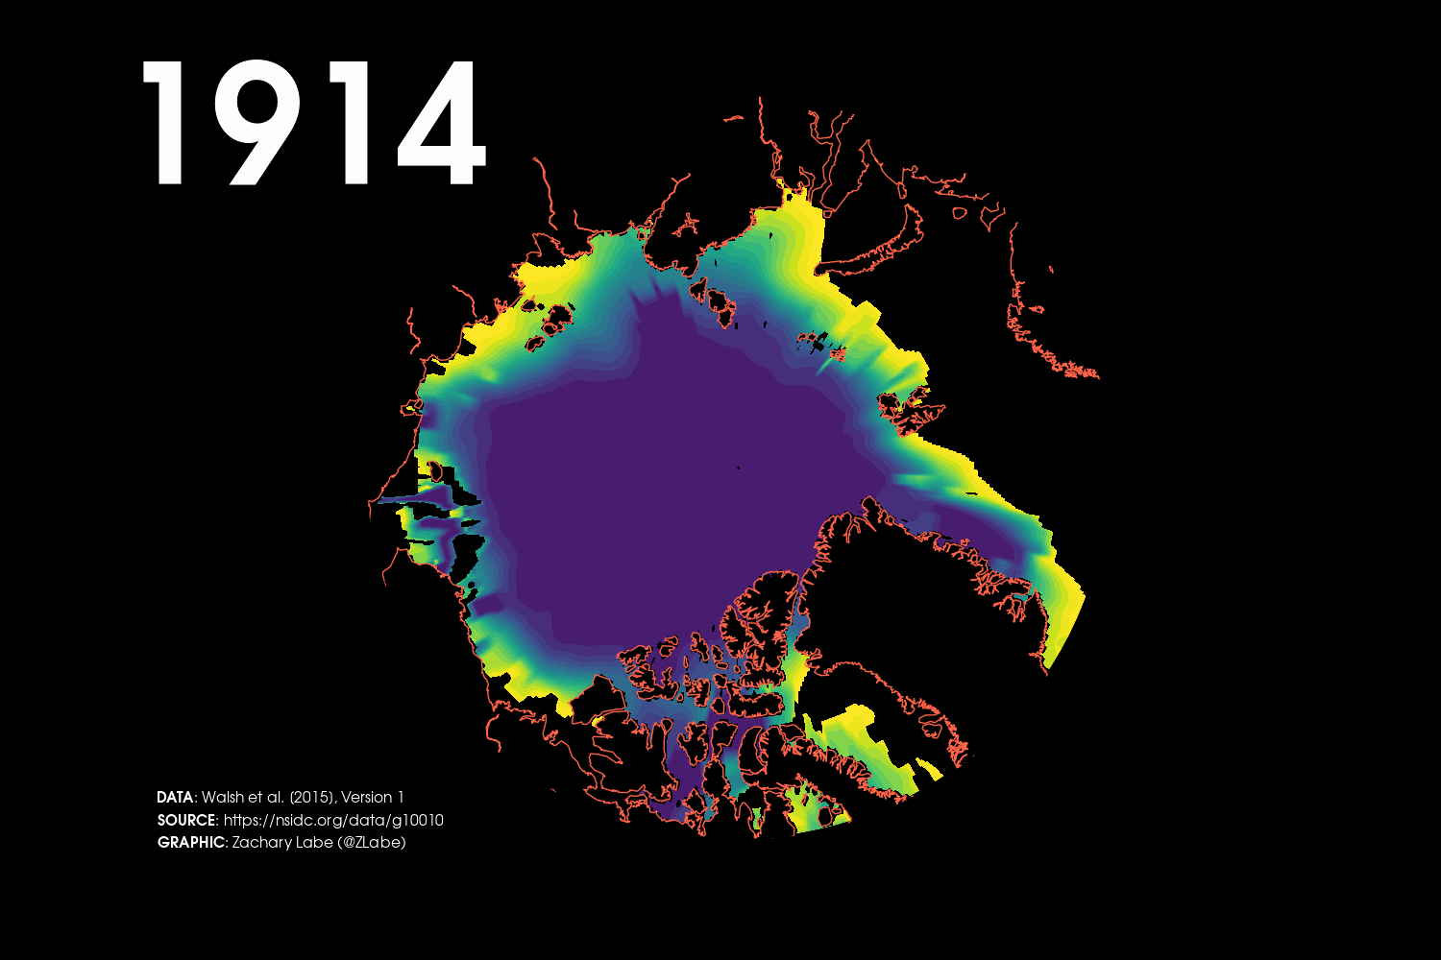

Slide 17
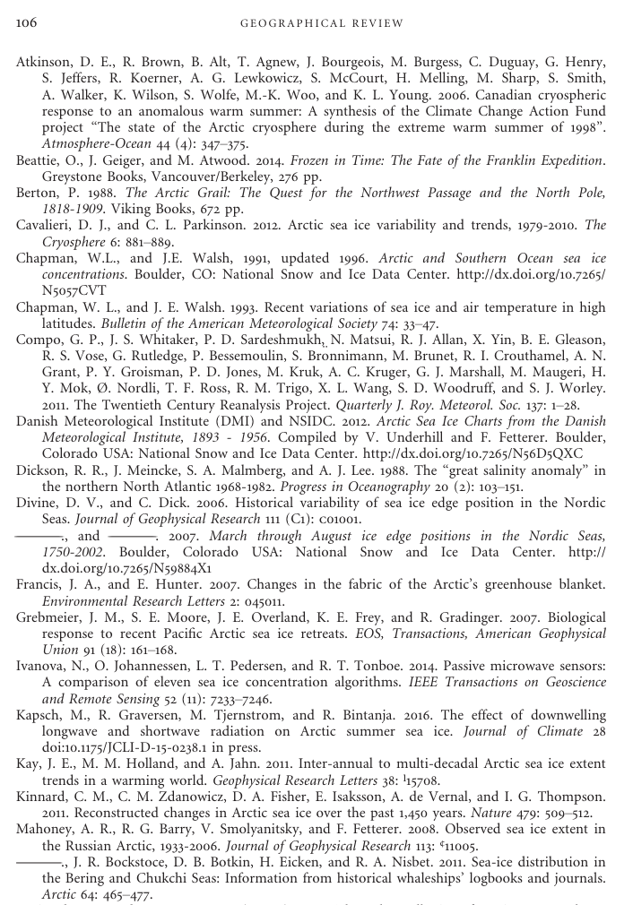
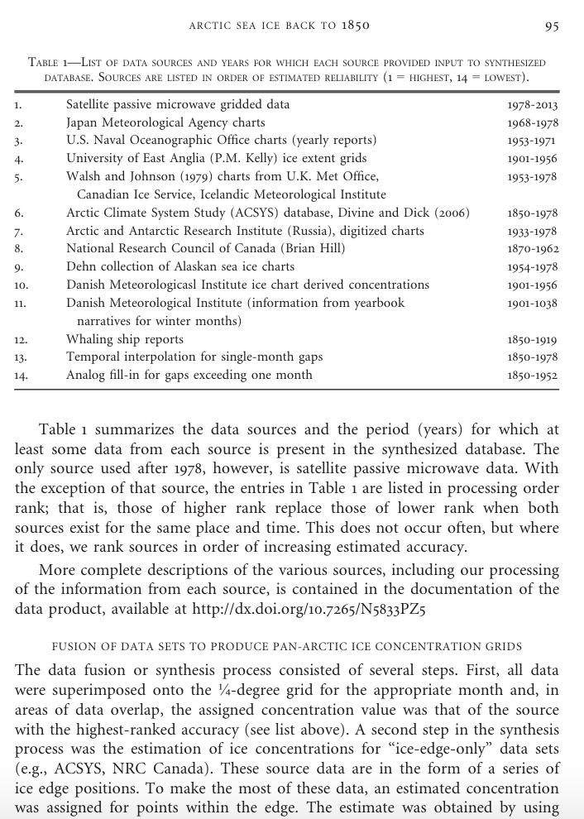
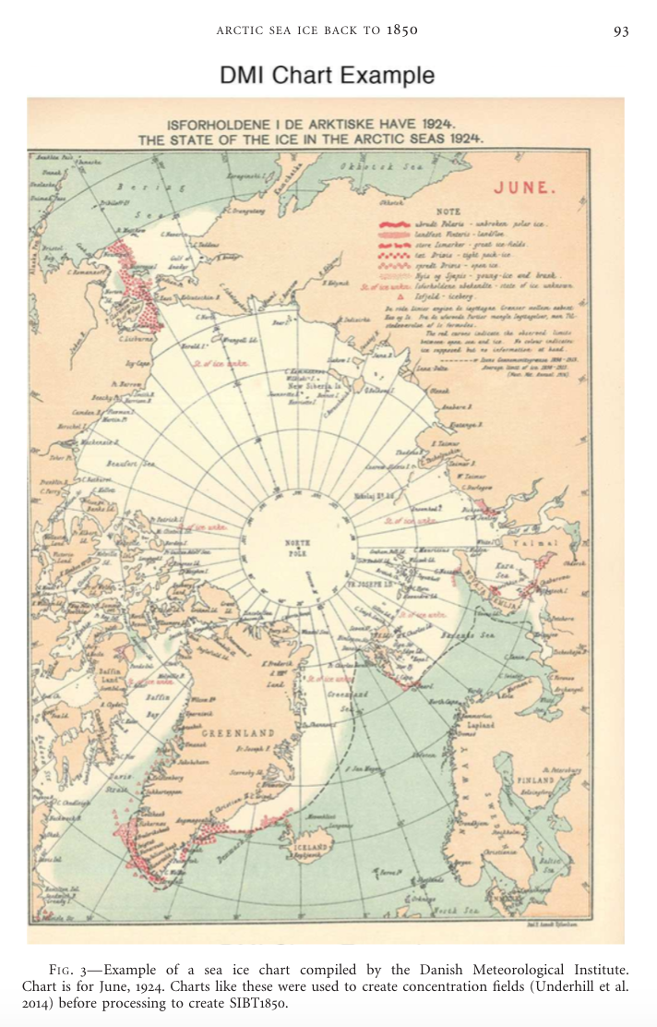
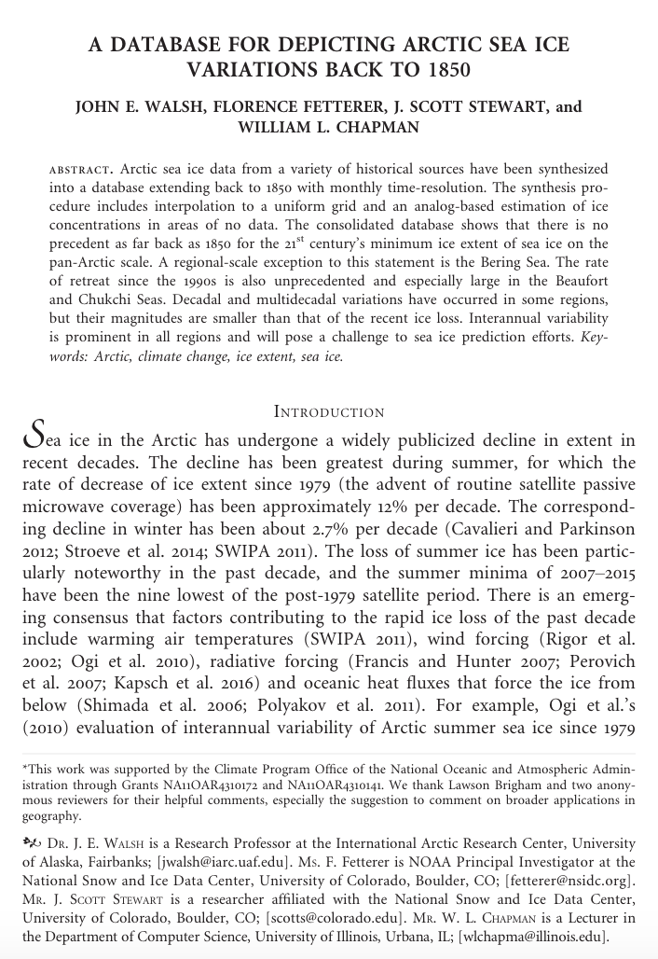
A database for depicting Arctic sea ice variations back to 1850
John E. Walsh,
Florence Fetterer,
J. Scott Stewart,
William L. Chapman
11 June 2016
Geographical Review
Helpful References
Guest post: Piecing together the Arctic’s sea ice history back to 1850 [Carbon Brief]
Arctic Summer Sea Ice – Going Down, Down, Down [The New York Times]
Historical Data Shows Arctic Melt of Last Two Decades Is 'Unprecedented’ [InsideClimate News]
Data: https://nsidc.org/data/g10010

Slide 18
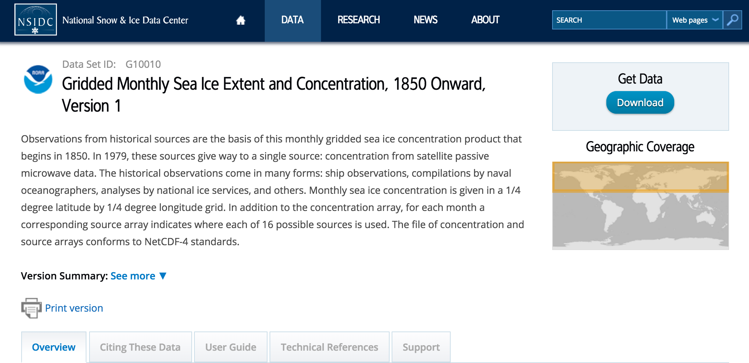
https://nsidc.org/data/g10010
File Format
Documentation

Slide 19
Sea Ice Extent
Sea Ice Concentration
Sea Ice Thickness
Area of seawater covered by any amount of ice
Depth between sea surface and ice/snow layer
Fraction (%) of seawater covered by ice
Terminology.
Snow
Ice
[ SIE ]
[ SIC ]
[ SIT ]

Slide 20
Sea Ice Extent
Sea Ice Concentration
Sea Ice Thickness
Area of seawater covered by any amount of ice
Depth between sea surface and ice/snow layer
Fraction (%) of seawater covered by ice
Snow
Ice
[ SIE ]
[ SIC ]
[ SIT ]

Slide 21
Sea Ice Extent
Sea Ice Concentration
Sea Ice Thickness
Area of seawater covered by any amount of ice
Depth between sea surface and ice/snow layer
Fraction (%) of seawater covered by ice
Snow
Ice
[ SIE ]
[ SIC ]
[ SIT ]

Slide 22
Sea Ice Extent
Sea Ice Concentration
Sea Ice Thickness
Area of seawater covered by any amount of ice
Depth between sea surface and ice/snow layer
Fraction (%) of seawater covered by ice
Snow
Ice
[ SIE ]
[ SIC ]
[ SIT ]

Slide 23
Newspapers, diaries, ship observations
Whaling ship logbooks
Sea ice edge positions from Canada (1870-)
Aerial ice surveys from Russia (1933-)
Passive microwave satellite (1979-)
DATA SOURCES

Slide 24
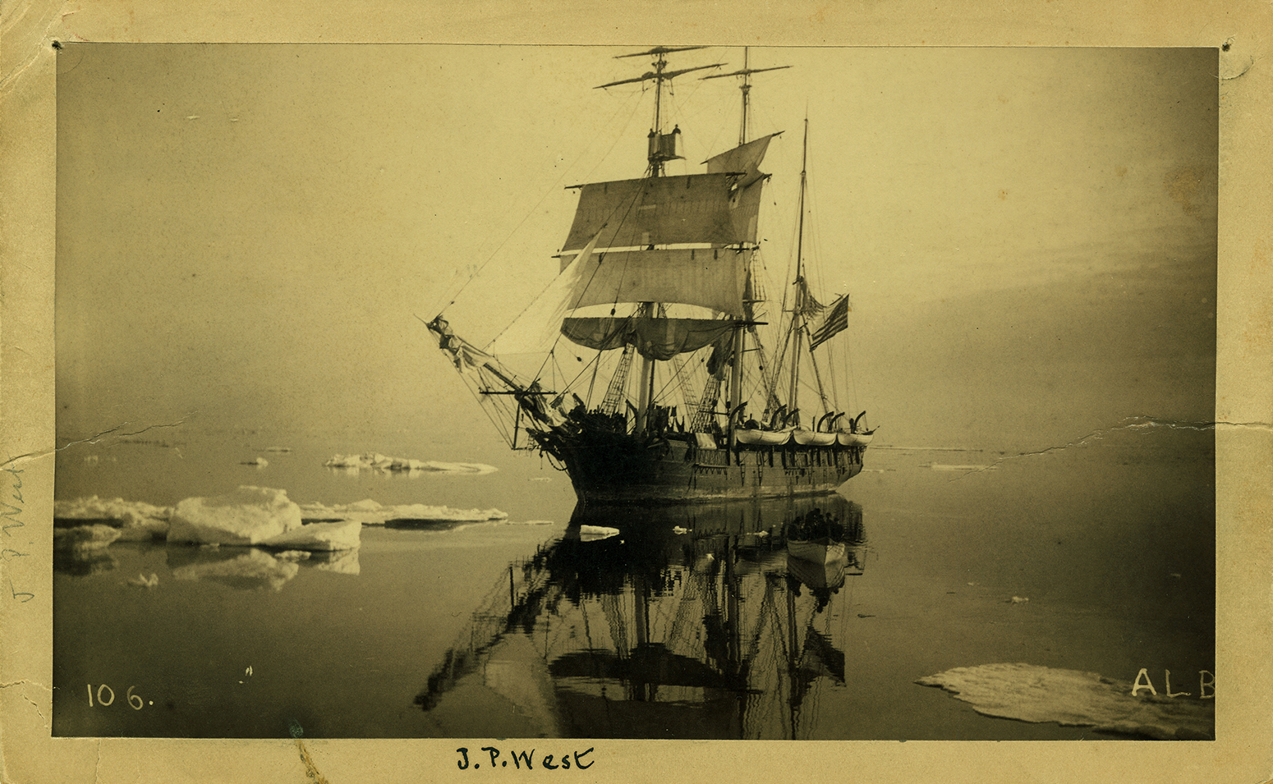
Walsh et al. [2016]

Slide 25
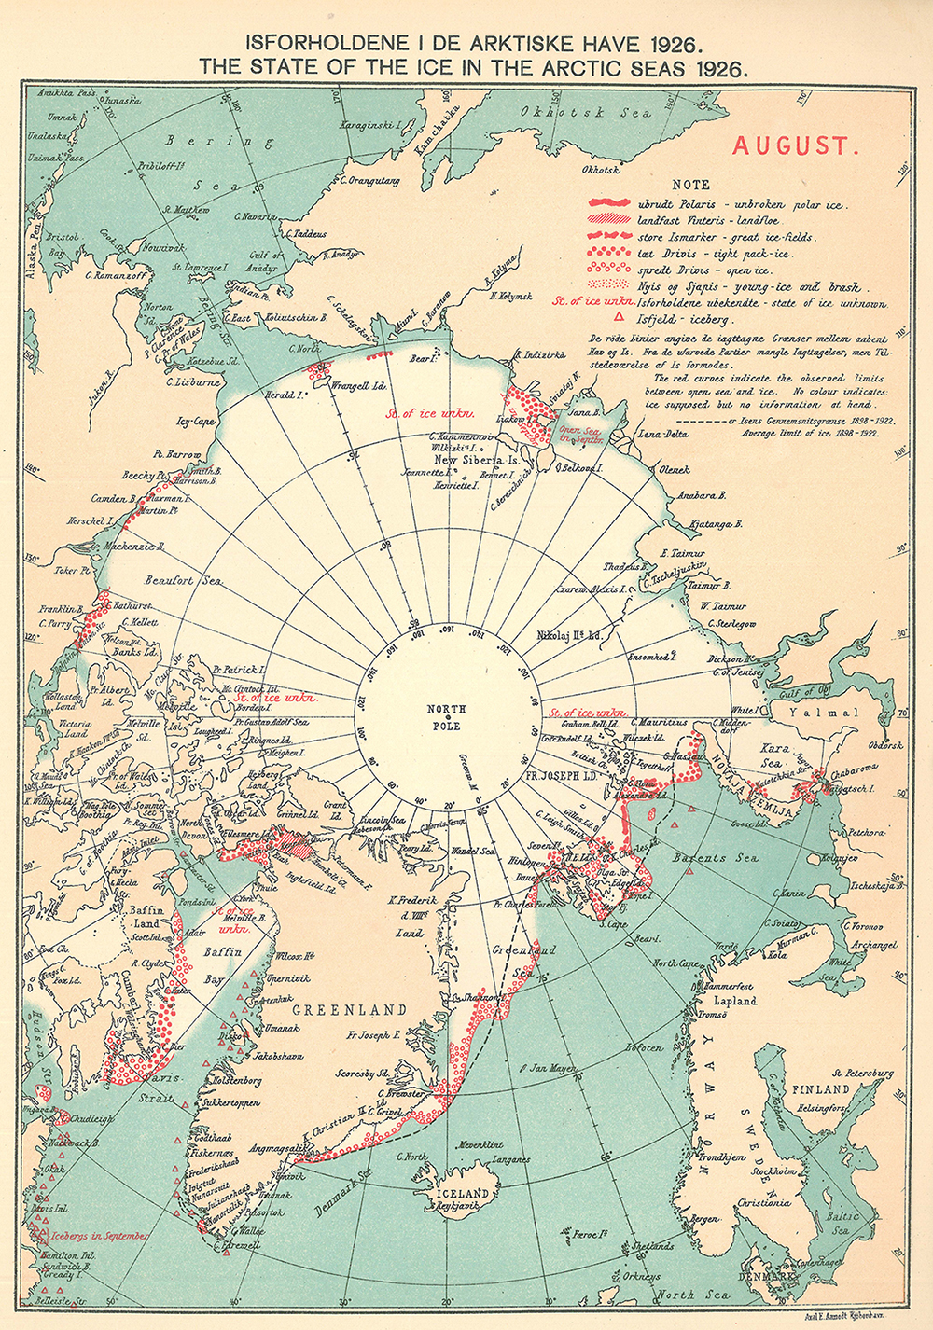
Walsh et al. [2016]

Slide 26
How has the rate of sea ice retreat changed over the last 150 years?
What regions of the Arctic Ocean are seeing the largest change in annual sea ice?
What are some of the differences in fall vs. spring sea ice trends?
SIGNIFICANCE

Slide 27
A database for depicting Arctic sea ice variations back to 1850
John E. Walsh,
Florence Fetterer,
J. Scott Stewart,
William L. Chapman
11 June 2016
Geographical Review
Helpful References
Guest post: Piecing together the Arctic’s sea ice history back to 1850 [Carbon Brief]
Arctic Summer Sea Ice – Going Down, Down, Down [The New York Times]
Historical Data Shows Arctic Melt of Last Two Decades Is 'Unprecedented’ [InsideClimate News]
Data: https://nsidc.org/data/g10010

